Slide 1

DRIVER DROWSINESS DETECTION SYSTEM
TEAM MEMBERS
1.ROAHIYAA T -CB.SC.U4AIE24043
2.SHIVANANDANA A -CB.SC.U4AIE24049
3.SRINITHI K -CB.SC.U4AIE24055
4.VANI SHREE S -CB.SC.U4AIE24059
1

Slide 2
INTRODUCTION
As the number of vehicles on the road increases daily, the number of accidents occurring around the world has also increased.
Traditional drowsiness detection systems rely on blink rate sensors or head movement tracking, which often fail in real-world condition
This project presents an AI-powered driver drowsiness detection system that integrates YOLOv8 and CNN to enhance accuracy and efficiency
YOLO identifies the driver's face and extracts relevant regions, while CNN classifies whether the driver’s eyes are open or closed and detects yawning.
If the system detects prolonged eye closure and yawning, it triggers an alert to prevent potential accidents.
2

Slide 3
OBJECTIVES
Develop a real-time driver drowsiness detection system that combines the strengths of object detection and classification models.
Utilize YOLOv8 for accurate and real-time detection of eye and mouth regions from video frames.
Employ Convolutional Neural Networks (CNNs) to classify:
a. Eye state (open or closed)
b. Yawning behavior (yawn or no yawn)
Enhance road safety by providing an early warning mechanism that alerts drivers when signs of drowsiness are detected.
1. Helps prevent accidents caused by fatigue and inattention.
2. Aims to be implement in real-world driving conditions using live video feeds.
3

Slide 4
Ensure high accuracy and real-time performance by implementing:
1. Efficient deep learning models.
2. Optimized pipelines for simultaneous detection and classification.
Reduce false alarms and increase system reliability by implementing a multi-feature detection strategy:
1. Triggers an alert only when both eye closure and yawning are detected.
2. Avoids unnecessary interruptions from single-feature misclassifications.
4

Slide 5
General Architecture of a Convolutional Neural Network (CNN)
1. Input Layer
Accepts raw image data (e.g., 64×64×3 for RGB, or 64×64×1 for grayscale)
No computation is done here; just passes data to the next layer
2. Convolutional Layers
Applies multiple filters/kernels ( 3×3) to extract features like edges, textures, shapes
Each convolution layer generates a feature map
5

Slide 6
3. Activation Function
Commonly ReLU (Rectified Linear Unit)
f(x)=max⁡(0,x)
Introduces non-linearity to allow the network to learn complex patterns
4. Pooling Layers
Reduces spatial dimensions (downsampling) and retains important features
Common types:
Max Pooling: Takes the maximum value
Example: 2×2 max pooling reduces a 64×64 feature map to 32×32
5. Dropout Layer
Randomly deactivates neurons during training to prevent overfitting
Helps in improving generalization
6

Slide 7
6. Flatten Layer
Converts 2D feature maps into a 1D vector
Prepares the data for the fully connected (dense) layers
7. Fully Connected (Dense) Layers
Standard neural network layers
Each neuron is connected to all neurons in the previous layer
Performs high-level reasoning and combines features to make decisions
8. Output Layer
Final decision-making layer
Multi-class classification → with Softmax
7

Slide 8
9. Loss Function & Optimizer
Loss Function: Measures error
Multi-class Classification
Optimizer: Updates weights
Adam
8

Slide 9
FUNCTIONING OF CNN...
CNN Architecture & Layers in Our Project
1.Convolution Layer (Feature Extraction)
Applies small filters (kernels) to the image to detect edges, textures, and patterns.
Feature Map=Input image * kernel
2. ReLU Activation (Non-Linearity)
Converts negative values to zero so only important features are passed forward.
f(x)=max(0,x)
3. Pooling Layer
Reduces image size while keeping the most important features, making the model faster.
P(i,j)=max(Feature Values)
4. Flatten Layer (Converts to 1D)
Converts the feature map into a single long vector to pass into the final layer.
5. Fully Connected Layer (Final Prediction)
Uses all extracted features to classify the image (Open/Closed Eyes, Yawn/No Yawn).
9

Slide 10
YOLOv8 Network Architecture
YOLOv8 is built using three major components:
Backbone → Neck → Head
1. Backbone – Feature Extraction
This part extracts key visual features from the image (edges, textures, shapes).
These features help the model understand where things might be in the image.
2. Neck – Feature Fusion
Merges features from different scales (low-res + high-res) to detect both small and large objects.
It helps the model not miss small details like an eye or a mouth.
3. Head – Output Predictions
The head produces final predictions: bounding boxes, confidence scores, and class probabilities.
10

Slide 11
FUNCTIONING OF YOLO.....
Step 1: YOLO Splits the Image into a Grid
YOLOv8 takes the input image (e.g., 640×480) and divides it into a grid of smaller cells.
The image is split into a 20×15 grid = 300 cells.
Each cell is responsible for detecting objects whose center falls inside it.
This grid-based approach enables YOLO to analyze multiple regions of the image simultaneously and in real time.
Step 2: Each Grid Cell Predicts Objects
Each grid cell predicts:
Bounding box coordinates: (x, y, width, height)
Objectness score: How likely it is that an object is present in the box
11

Slide 12
Step 3: Classifies Objects
If a grid cell detects an object, YOLO assigns a class label (e.g., "Face", "Mouth", "Yawning").
The model predicts a class probability distribution for each bounding box.
This tells us what type of object the detected region is — not just that something is there.
Step 4: Non-Maximum Suppression (NMS)
Since multiple grid cells may predict overlapping boxes for the same object, YOLO uses Non-Maximum Suppression.
NMS selects the box with the highest confidence score, and removes overlapping boxes.
This leaves only the most accurate box per object.
12

Slide 13
METHODOLOGY
How Our System Works
We followed a step-by-step process to build a system that can find out if a driver is feeling sleepy.
Our main steps were:
Getting images to train our models
Training CNN models to check if eyes are open or closed and if the mouth is yawning
Training a YOLOv8 model to find face parts like eyes and mouth in real time
Bringing everything together to make a full system that can check for sleepiness while someone is driving
13

Slide 14
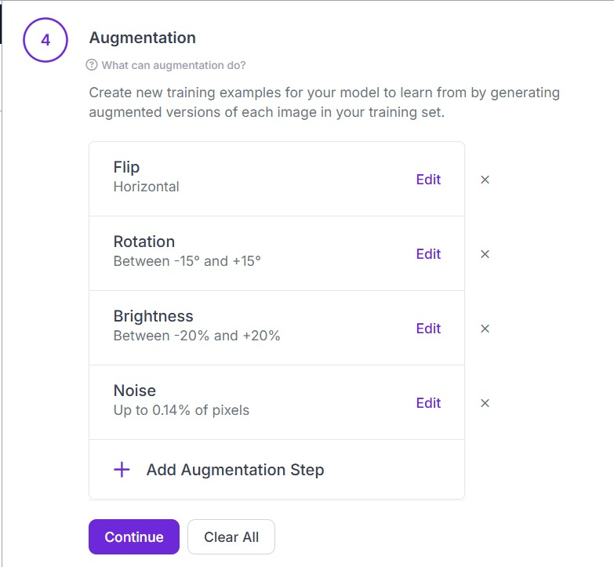
IMPLEMENTATION
Collecting Images
We used images (725) from Kaggle to train our models
For checking the state of eyes and mouth, we used a dataset with images of open/closed eyes and yawn/no yawn faces
To improve mouth detection, we manually cropped the mouth area from images and made a better dataset
For object detection, we used another face dataset and added labels to 1,648 images to mark eyes, mouth, and face
Then we increased the number of images to 3,088 using features like flipping, rotating, and and adjusting brightness , noise (data augmentation)
14

Slide 15
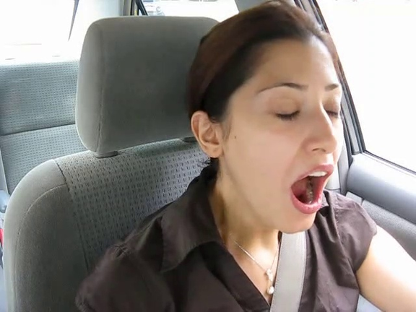


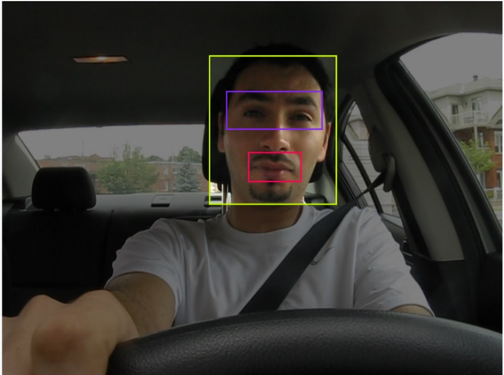
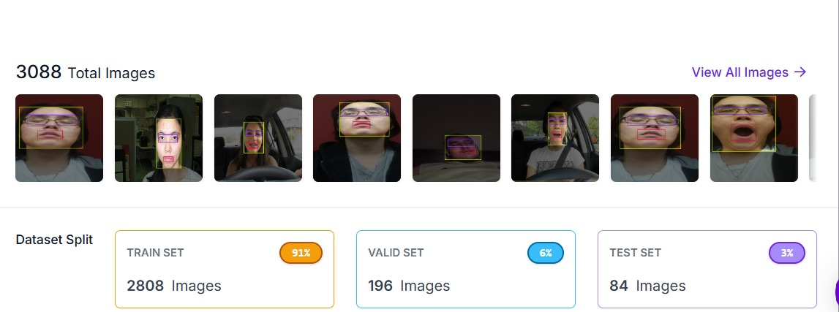
15

Slide 16
CNN Models
We trained two CNN models:
One model checks if the eyes are open or closed
Another model checks if the person is yawning or not
These models were trained using the image datasets we created. After training, we saved them so we could use them in our real-time system.
These models help us know what the driver is doing in each frame.
YOLOv8 Detection
We used YOLOv8 to find the eyes, mouth, and face in the camera feed.
YOLO was trained on our labeled images
It can detect the correct parts of the face even when the person moves or the lighting changes
This helps us find where the eyes and mouth are in each frame, so we can check them using the CNN models
16

Slide 17
Real-Time System Setup
Using All Models Together
After training all models, we made a system that works with a webcam in real time.
YOLO finds the eyes and mouth
Those parts are cropped and sent to CNN models
CNN checks if the eyes are closed and if the driver is yawning
This happens in every frame, so the system can keep watching and update the status quickly.
17

Slide 18
Detecting Sleepiness
Drowsiness Logic
We used simple rules to decide if the driver is sleepy:
If eyes are closed again and again, we increase microsleep time
If yawns happen often, we increase yawn count and yawn time
Based on this, we show a warning:
if microsleeps > 4 and yawns >= 3:
🚨 Driver is SLEEPING
else if microsleeps > 2 or yawns >= 2:
⚠️ Driver Might Feel Drowsy
else:
✅ Driver is Awake
This helps the system to know when the driver is fully sleepy or just a little tired, and show alerts on screen.
18

Slide 19
RESULT
The system detects eye state (open/closed) and yawning (yes/no) in real-time video.
YOLOv8 accurately locates the face, eyes, and mouth for consistent input to CNNs.
CNN classifiers work reliably across different lighting and face angles.
Eye and yawn detection together help reduce false alerts.
19

Slide 20
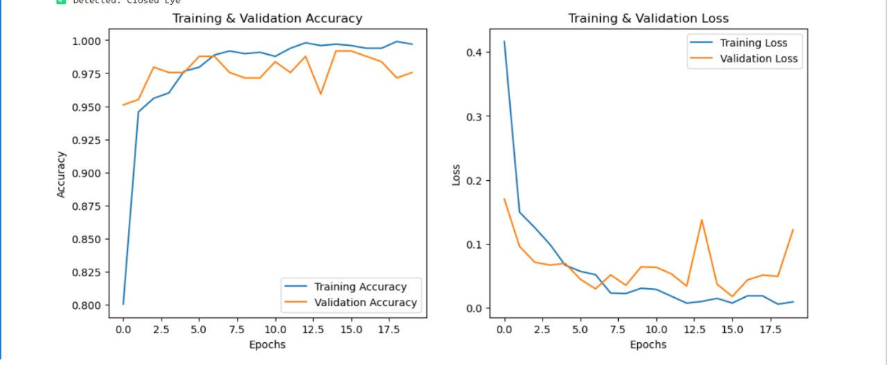
ANALYSIS
Training & Validation Accuracy (Left Graph)
High accuracy (~98%) suggests a well-trained model
Training & Validation Loss (Right Graph)
Low loss values indicate the model is making correct predictions.
20

Slide 21
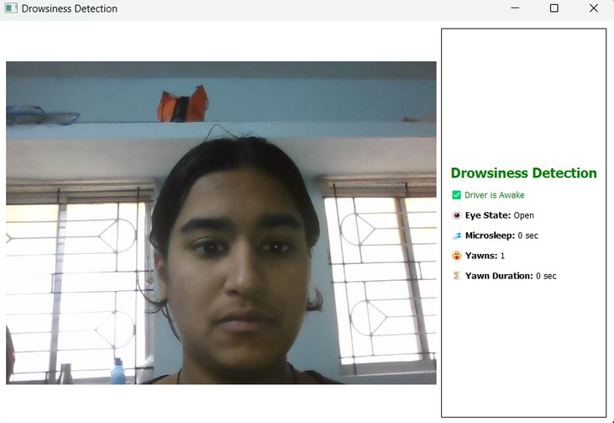
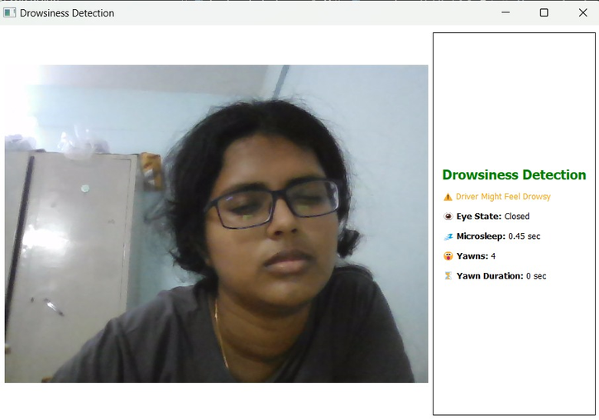
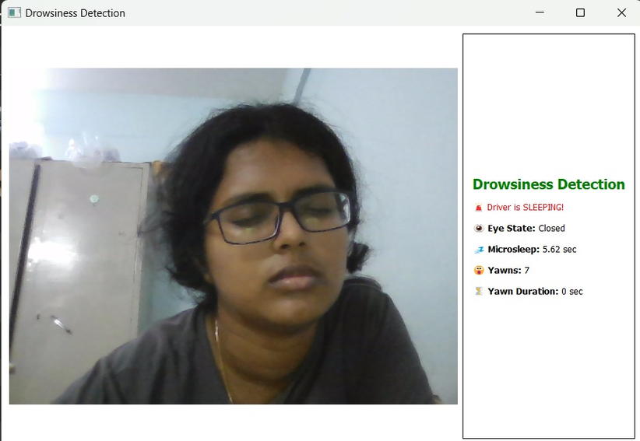
21

Slide 22
DISCUSSIONS
The project uses a multi-stage deep learning pipeline combining YOLOv8 for detection and CNNs for classification.
YOLOv8 enables accurate real-time detection of face and mouth regions, which ensures consistent input quality for downstream classification.
Two separate CNN models were trained for:
Eye state classification (open/closed)
Yawn detection (yes/no) from YOLO-detected mouth regions
Integration of both models allows the system to trigger alerts only when both eye closure and yawning are detected, reducing false positives.
The modular approach improves flexibility and system maintainability.
22

Slide 23
CONCLUSION
The developed system reliably detects drowsiness indicators using visual cues: eye closure and yawning.
The combination of YOLOv8 for localization and CNNs for state classification enables high accuracy with real-time performance.
Experimental results validate the robustness of the system in various lighting and facial orientation conditions.
This approach is practical for driver monitoring systems, providing timely alerts to help prevent road accidents.
23

Slide 24
FUTURE WORK
Enhance dataset diversity with more ethnicities, lighting conditions, and occlusions for better generalization.
Fuse additional drowsiness cues like head tilting, blink rate, or voice tone for a more holistic assessment.
Deploy on embedded systems (e.g., Jetson Nano, Raspberry Pi) for edge computing in vehicles.
Explore attention-based models or transformer architectures for more accurate region focus and classification.
24

Slide 25
THANK YOU!
25

